Slide 1
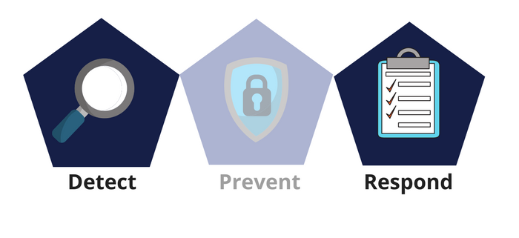



Network Security
Class IX
lab 29

Slide 2

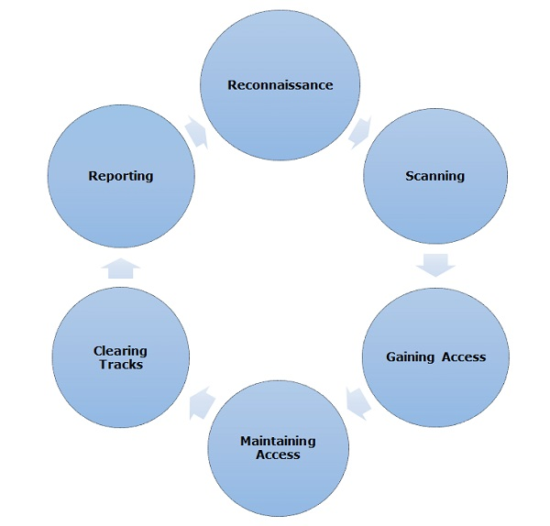
Ethical Hacking Process

Slide 3

Footprinting
by Footprinting Ethical Hacker can collect
Domain name
IP Addresses
Namespaces
Employee information
Phone numbers
E-mails
Job Information

Slide 4
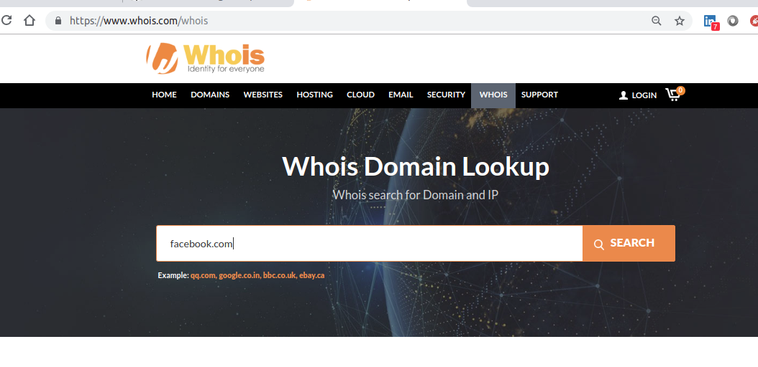
Domain Name Information
whois helps to collect domain name information

Slide 5


Finding IP Address
use ping from Linux terminal or windows command prompt to extract IP Address of any web site

Slide 6
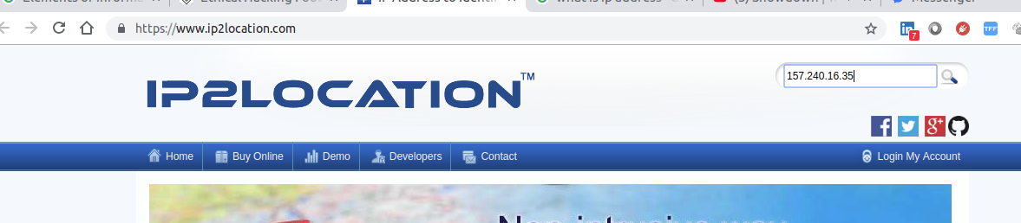
Finding Hosting Company
use ip2location.com to find the hosting company of a website

Slide 7

IP Address Ranges
use ARIN to get the range of IP addresses assigned to a particular company using

Slide 8
Thank You

